Slide 1

PROJECT ON CAR INSURANCE CLAIM
Submitted By;
Sherin Joseph
16/August/2021
Instructor:
Tareq Jaber

Slide 2

INTRODUCTION
The project deals with the car insurance claim of 4 different postal codes
The insurance company tries to find the categories which had more claims
The objective of the project is to get insights on the several factors associated with the claim
The insights might lead to recommendations which could make the business cost effective and quote the insurance price for different categories of people in the future

Slide 3
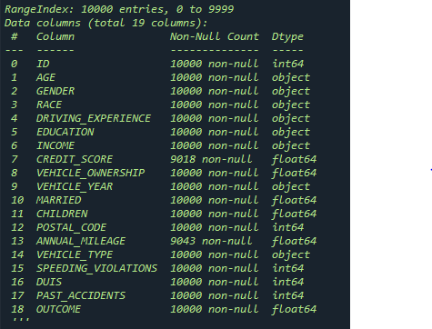
Data SET
There are total 10000 rows and 19 columns in the data set provided

Slide 4
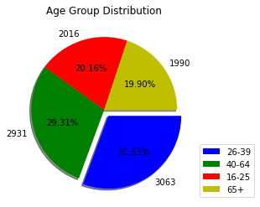
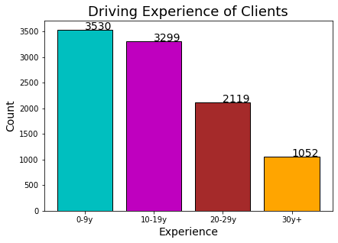
1. What is the age and driving experience distribution among applicants of the claims
The majority of the claims were from the age group “26-39” and the minimum were from the age group “65+”.
The people with driving experience of “0-9 y” made the maximum number of claims where as the most experienced drivers in the group “30 y +” had the least claims

Slide 5
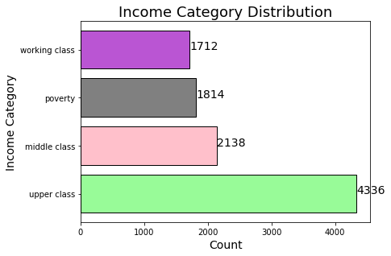
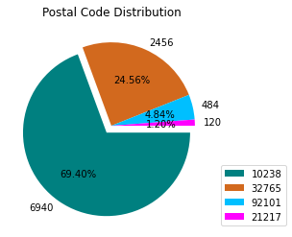
2. Find the Income and postal code distribution of the claims
The upper class people contributed the maximum claims at 4336, followed by middle class and poverty at 2138 and 1814 respectively.
The working class people had the least claims among all the groups.
The pie chat clearly reveals that the postal code “10238” had the maximum share of all the claims at 69.40%.
Only a minor share of 1.20% was from the postal code “21217”.

Slide 6
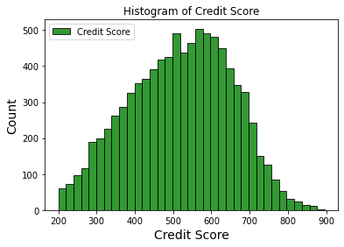
3. Find the distribution of credit score across the claims
The histogram shows that the credit score of the applicants were ranging between 200 to 900.
Most of the score were between 400 to 700 and the trend showed a decrement towards either sides beyond the said interval.

Slide 7
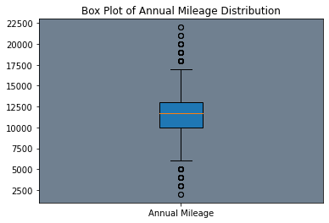
4. Find the distribution of Annual Mileage across the claims
The box plot shows the distribution of the Annual mileage of the cars for the claims have been made.
The majority of the cars had the mileage between 10k and 13k.
However minor exceptions are there where 4 claims had the car mileage under 6k and 5 claims where mileage was above 17.5k

Slide 8
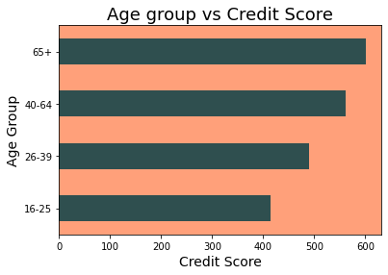
5. Find the Average Credit Score according to the age group of the customers who claimed insurance
The horizontal bar chart shows that the age group “65+” had the highest average credit score among all other groups, of around 600.
The least average was for the age group “16-25” of only around 420.

Slide 9
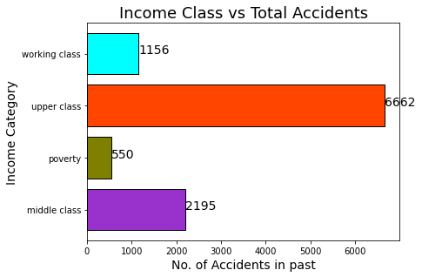
6. Which Income class of clients made maximum accidents in the past
The horizontal bar chart illustrates that the “upper class” people made a total number of 6662 accidents in the past.
The “middle class” and “working class” followed with 2195 and 1156 accidents respectively.
The people belonging to the class “poverty” made the least accidents making the count of 550.

Slide 10
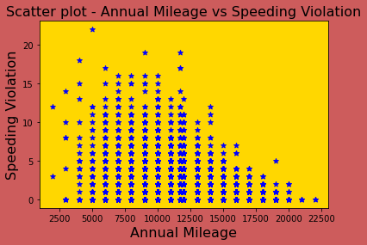
7. Is there any relation between Annual Mileage and Speeding Violations
The scatter plot displays the correlation between Annual mileage and speeding violation.
The right skewed distribution explains that most of the violations were made with cars having annual mileage between 5k and 15k and for the cars that had highest annual mileages, the violations were less.

Slide 11
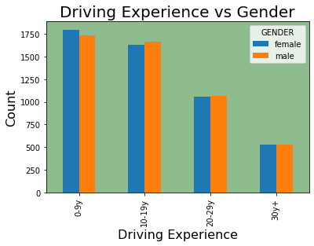
8. Who made more claims : male or female and based on their driving experience
The grouped vertical bar chart clearly reveals that the females with ‘0-9y’ driving experience made more claims than males in same category.
Both in ’10-19y’ and ’20-29y’ diving experience category, the claims made by male were slightly higher than the females.
However, both male and female divers with ’30y+’ driving experience had equal number of claims.

Slide 12
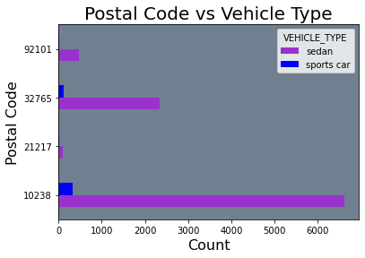
9. Which vehicle type had more claims across the different postal codes.
From the grouped horizontal bar chart, it is clear that in all postal codes, “sedan” cars had more claims than the “sports cars” by a great margin.

Slide 13
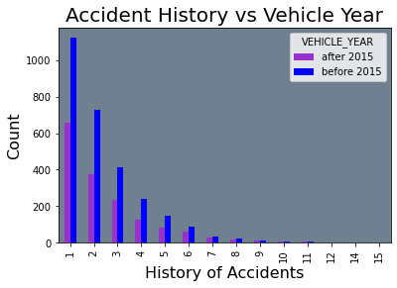
10. Which cars (based on vehicle year) had at least one history of accidents
From the grouped vertical bar chart, the cars made before 2015 dominated in each group of accident histories compared to the cars made after 2015.

Slide 14
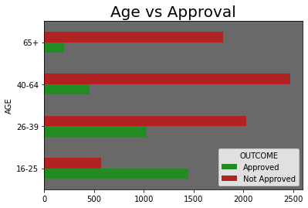
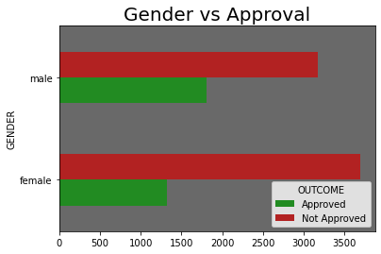
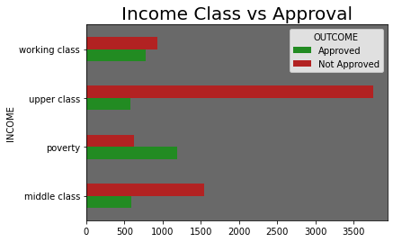
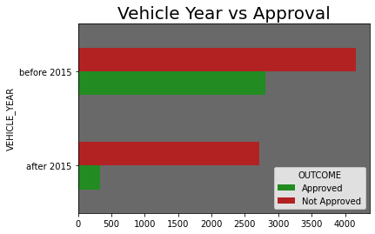
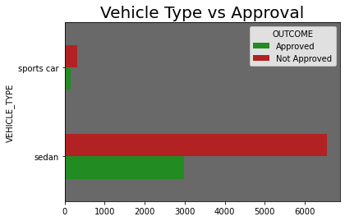
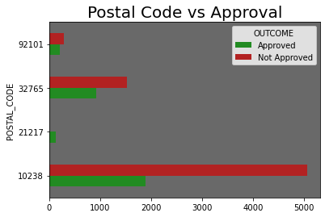
Claims approval based on Age, Gender, Income, vehicle year, vehicle type and postal code

Slide 15
CONCLUSION
The majority of claims were made by Age group "26-39“
People with more driving experience tend to have less claims
The upper class people were subjected to more accidents and had more claims than other group of people
Majority of claims were from postal code "10238" and "sedan cars " contributed more claims compared to "sports cars" in all areas
Average credit score of senior applicants were higher than youngsters who claimed insurance
When the driving experience increases, the claims will be fewer irrespective of the gender
Vehicles made before 2015 had more accident history than those made after 2015
The approval rate was higher than rejection only in age group "16-25", "poverty" class and in postal code "21217"

Slide 16
RECOMMENDATION
The insurance premium in the upcoming year could be reduced for the seniors and those with highest years of driving experience
Insurance premium could be reduced for new vehicles as they have lower accidents compared to old vehicles
Strategy should be developed to deal with postal code 21217 as despite of the low claims, the approval rate is way ahead of the claim rejection
Premium of Upper class people should be increased as they contribute major share of claim and also commit maximum accidents compared to others

Slide 17
THANK YOU

